Slide 1

Grocery Buddy
By Ecoders (Patrick, Raly, Kevin, Toni, and Carlo)
Notes:
Raly

Slide 2



What Does It Do?
“Make the most of out what you have”
Plan what you buy – Grocery Lists
Make sure you use it – Fridge expiry trackers and notifications
Notes:
Raly
Our app is called Grocery Buddy, and for those of you that are unfamiliar
Grocery Buddy is a shopping list app that tracks your food products and their expiration dates. It helps you plan what you need to buy and make the most of what you have.

Slide 3


Where we left off:
UI draft complete.
Site is Bootstrap responsive.
Angular 4 framework working.
Basic front-end functionality
Notes:
Raly
Last week, we finished Sprint 1 by meeting all of the preset goals that we set for that iteration. We mainly focused on finishing all of the front-end functionality.
We finished designing and implementing our User Interface.
Our app was styled with bootstrap which made it fully responsive.
Our app was built on an Angular 4 environment allowing Single-Page application
And we finished coding all of our front-end functionality with JavaScript and currently have them stored within JavaScript objects.

Slide 4

Sprint 2 Goals: Server Side
Research Data
Integrate with Database - Authentication - User Data (ex: lists) - Read Only Data (ex: expiry dates)
Achieve Full baseline functionality

Slide 5

Sprint 2 Goals: Client Side
Live expiration tracking
Log-in / log-out, account details
UI improvements
Challenge Integration
Notes:
Toni
UI improvements
Gestures
Bug-free
Responsive across all screen sizes

Slide 6
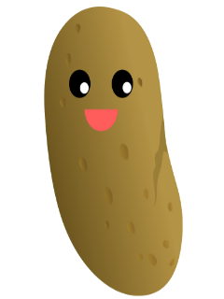

Sprint 2 Challenge:
Site hosting
https://grocerybuddy-fe337.firebaseapp.com/main
Edit affiliates
Take 2
Phoenix Recipes
iPicky
Easter egg

Slide 7
Task assignments:
Kevin - bug-fixing, assisting with database integration
Toni - bug-fixing, assisting with database integration
Raly - Structuring database, syncing client-side functions
Patrick - code port, Firebase integration, gestures
Carlo: easter egg implementation, notifications

Slide 8

Sprint 2 Scrumboard:
Click here!

Slide 9


Conclusion
THANKS!

